Slide 1
RAS
Functional Overview
1/11/2017

Slide 2
Why do we need RAS?
O&M: Monitor our customer’s assets to meet or exceed committed performance
Maximize the performance where possible, and capture part of that value
Manage our risks of premature failure, reducing warranty costs
Intelligent reporting about <0.1% of data
Notification system that can detect anomalies and alert before a failure occurs
Remotely diagnose assets for effective (one shot) maintenance
Remote parameter configuration/tweaking
Remote firmware update
Remotely control assets (on/off/derate/geo-boundaries)
Aggregate assets from BTM to Utility scale (fleet control)
Enable demand side management services and revenues
Provide responsive GUIs & dashboards to end users (resi, mobile, ...)
Data analytics, underpinning our value and technology
Dashboards and reports
A unified solution that matches the capabilities of our users
Go downstream !

Slide 3
Why do we want to build it in-house?
Evaluated countless third party solutions
Generic, rather than specific approach
Keeping the doors wide open for any IoT enabled asset
Yes – Batteries, inverters, motors, transformers, meters, ...
But also – boilers, PV, wind, flow, CHP, microturbine, ...
Or even – vending machines, companies, ... Litterally anything that produces data
Configurable, not just programmable
Ability to go foggy, not just cloud based
Third party solutions are expensive and create monthly costs
Flexibility to connect to third-party sources & tools
Create proprietary value, not only at the electrochemistry level
Cutting edge technology is not something you get off the shelve
Do something that leaves the Koreans and Chinese lightyears behind us
Be(come) a software company, in addition to the hardware !

Slide 4
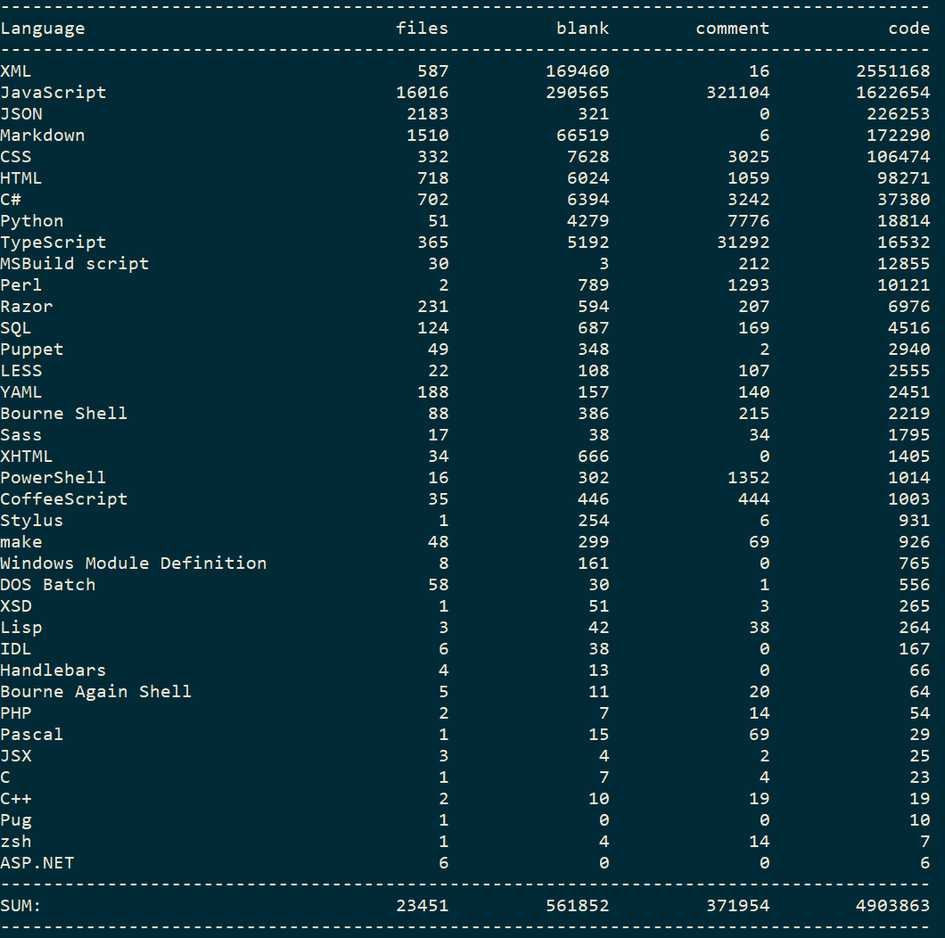
Technical details
C#:
HTML:
CSS:
Razor:
JavaScript:
37.380
98.271
106.474
6.976
1.622.654
Lines of code:
(Includes libraries)
Remaining work
Reporting (editor, viewer)
Event engine editor
Event engine
Data validation editor
Asset management
Firmware management (MFC only)
On-site RAS deployment
Rough estimate: +/- 160 man-weeks
RAS System monitoring
User management
Network environment
System security
Inbound handlers (FTPS + MQTT)
Live data monitor

Slide 5
Outline
Definitions
Infrastructure
Live demo

Slide 6
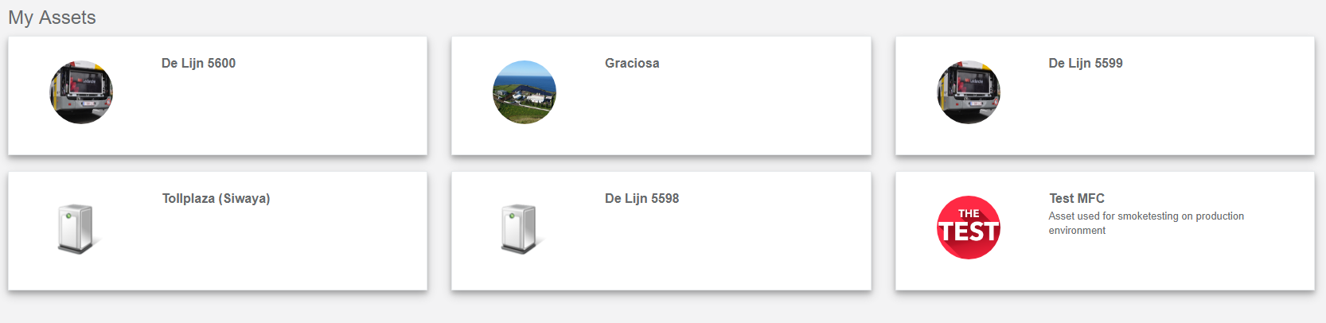
Definitions
Asset
An object that produces data
Can be multiple devices
One device can be multiple assets
Examples: Bus, Coffee machine, Fridge, …
Every asset has an assettype
Every asset has properties

Slide 7
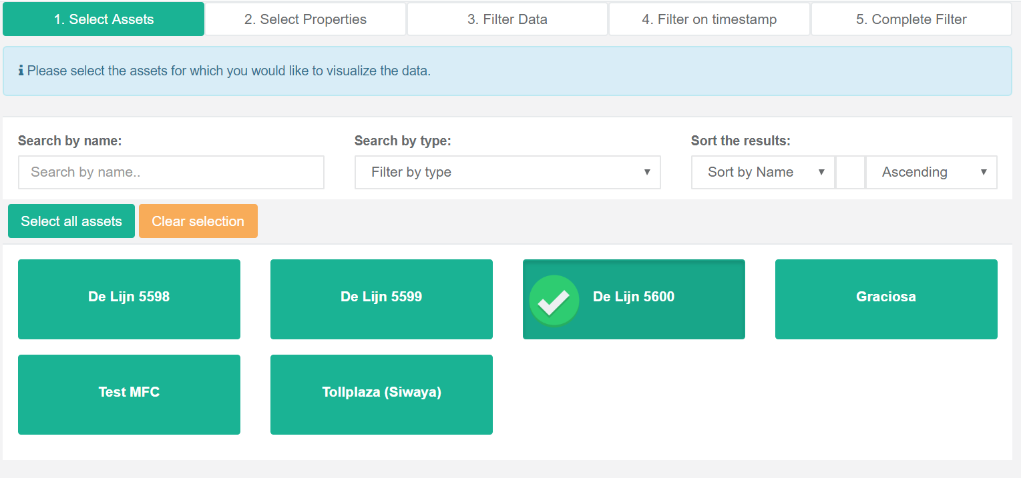
Definitions
Filter
Visually query the data of your assets

Slide 8
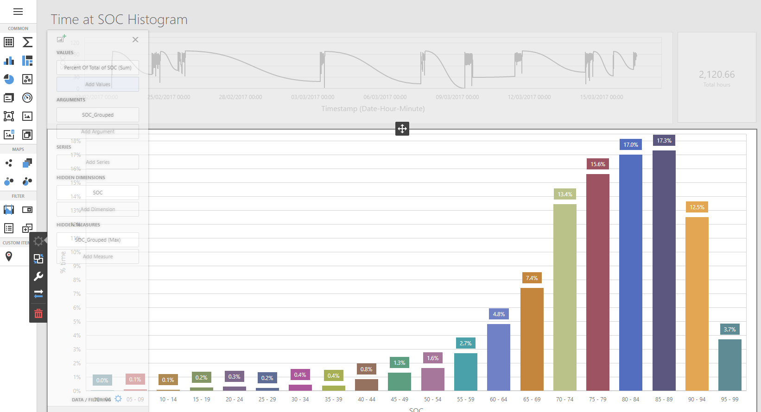
Definitions
Dashboard
Query and analyse data using a sophisticated charting editor

Slide 9
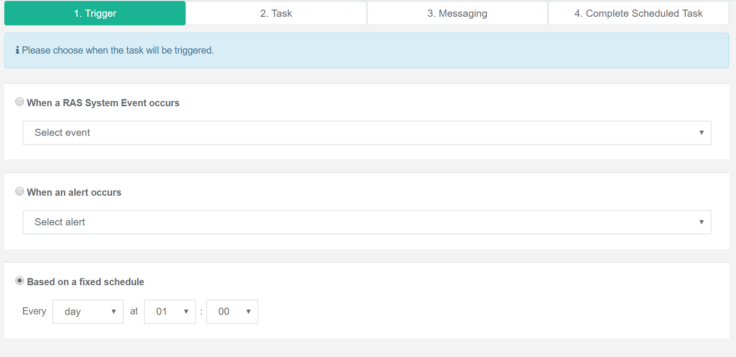
Definitions
Scheduled Task
Send a dashboard/report to someone on a specific schedule or when a certain event occurs

Slide 10
Definitions
Event
Based on specified data evaluation rules, events are raised and can be acted upon
Currently still being analyzed

Slide 11
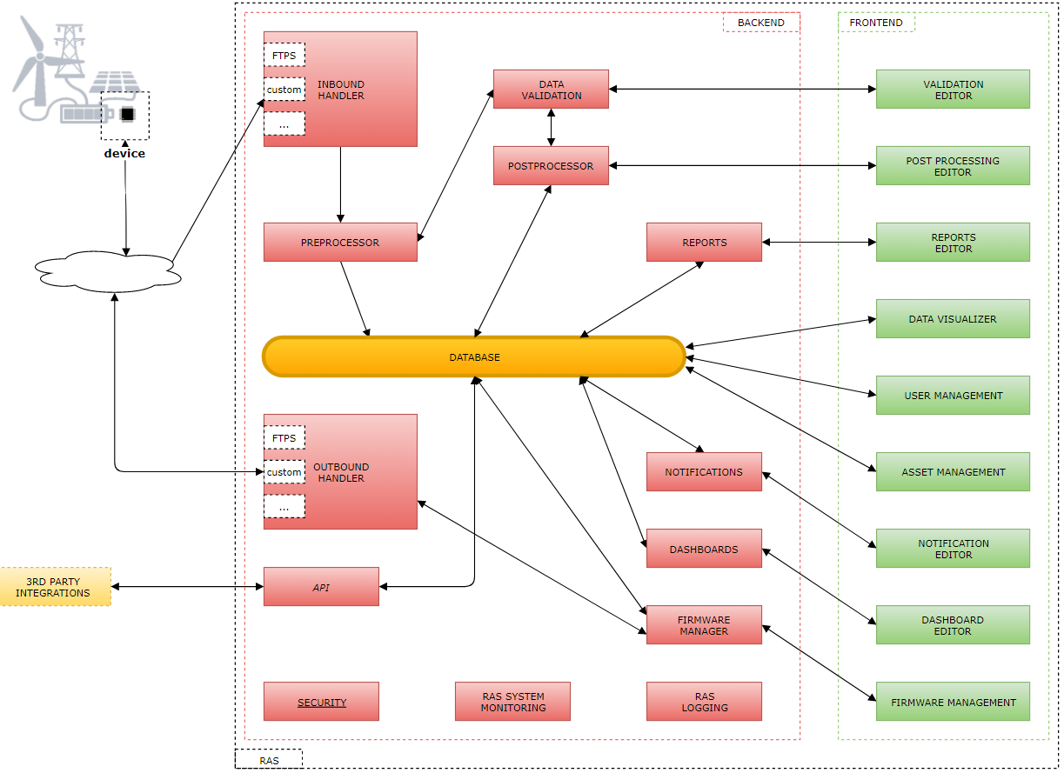
Architecture

Slide 12
Demo
Create a filter
Create a dashboard
Create a scheduled task

